Slide 1


Achieving Super-Linear Speedup across Multi-FPGA for Real-Time DNN Inference
CODES+ISSS 2019: International Conference on Hardware/Software Codesign and System Synthesis
Weiwen Jiang, Edwin H.-M. Sha, Xinyi Zhang, Lei Yang, Qingfeng Zhuge, Yiyu Shi, Jingtong Hu
University of Pittsburgh
East China Normal University
University of Notre Dame
Weiwen Jiang
Postdoctoral Researcher
University of Notre Dame
wjiang2@nd.edu
https://wjiang.nd.edu
Notes:
Thanks for the introduction. I’m glad to be here to present our work “achieving super-linear speedup across multi-FPGA for real-time DNN inference”.

Slide 2
Outline
Introduction
Super-LIP Framework
Experimental Results
Ultimate Goal
Notes:
In this talk, I’ll first present the introduction of this work. Then, I’ll show the super-LIP framework that is developed to achieve super-linear speedup across multiple FPGAs. After this, I’ll report the experimental results. Finally, I’ll outline our ultimate goal and show the important position of this work.

Slide 3
Outline
Introduction
Background
Motivation
Super-LIP Framework
Experimental Results
Ultimate Goal
Notes:
Let me first introduce the background and motivation of this work.

Slide 4
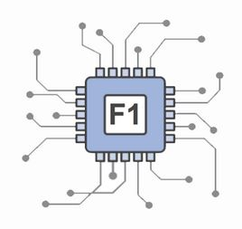

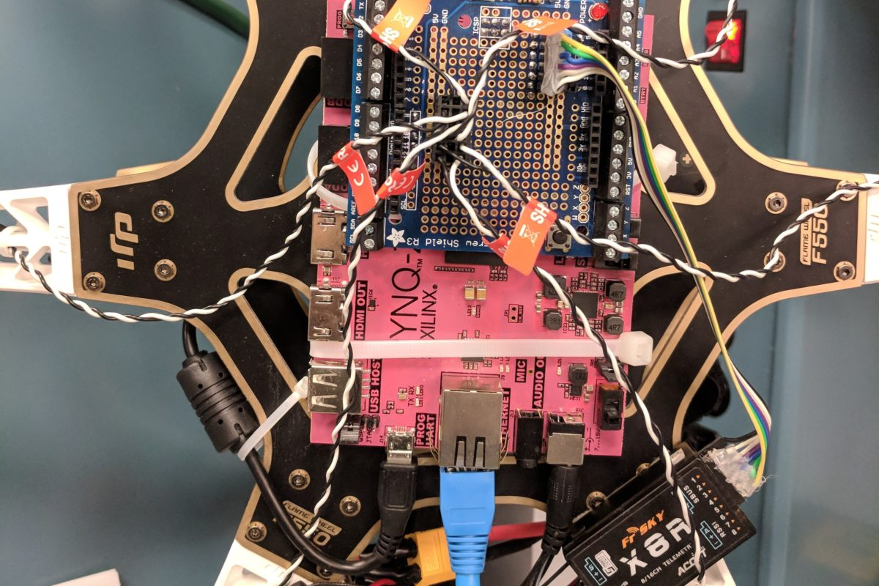


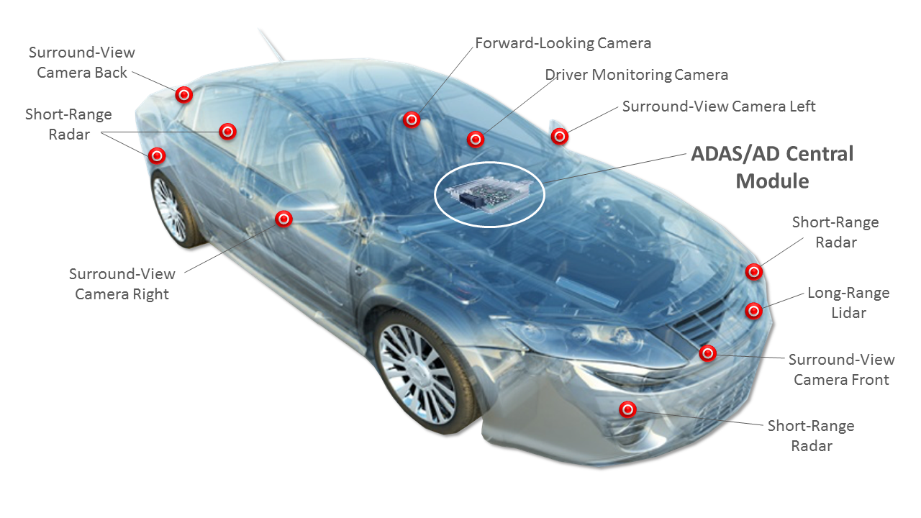


Background
FPGAs in DNN Applications
FPGA in Cloud Computing
FPGA in Edge Computing
[ref] Where Do FPGAs Stand in Auto IC Race? https://www.eetimes.com/document.asp?doc_id=1333419#
[ref] PYNQ on UAV http://brennancain.com/pynqcopter-an-open-source-fpga-overlay-for-uavs/
Notes:
Among different computing resources, due to the flexibility and energy efficiency, FPGA is one of the most promising platform to accelerate the DNN applications. As shown in this slides, in both cloud computing and edge computing, FPGAs are taken to implement DNNs.

Slide 5
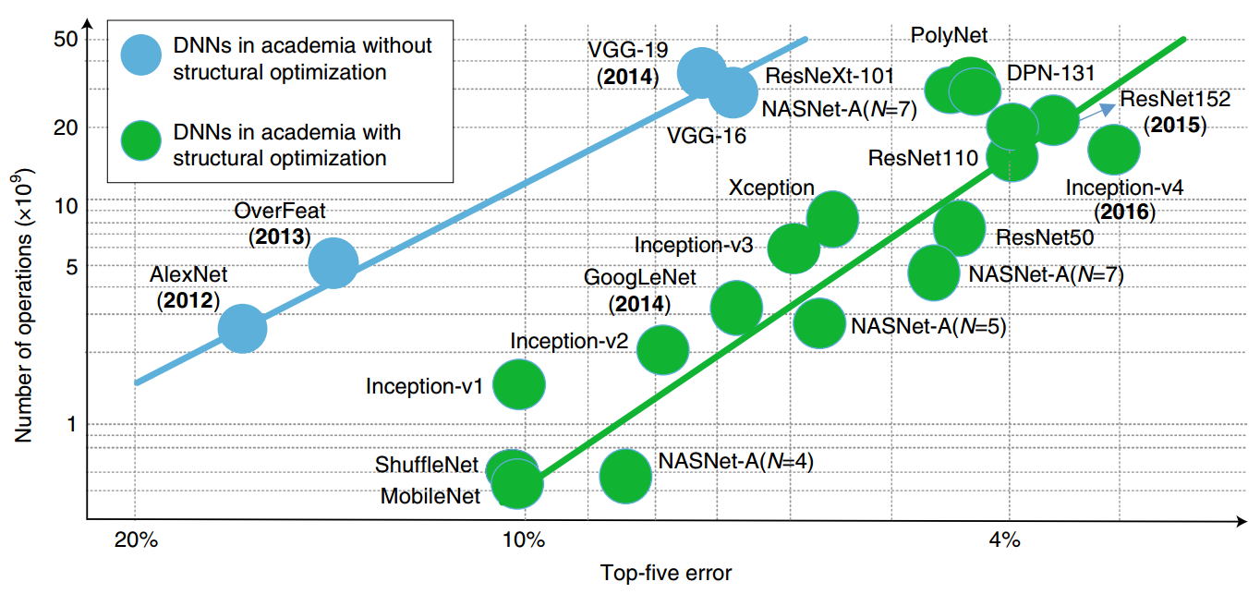
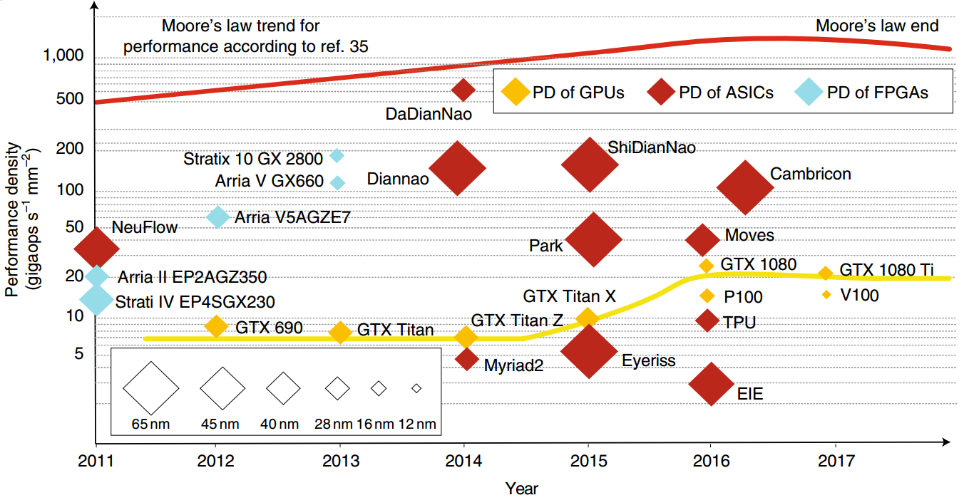
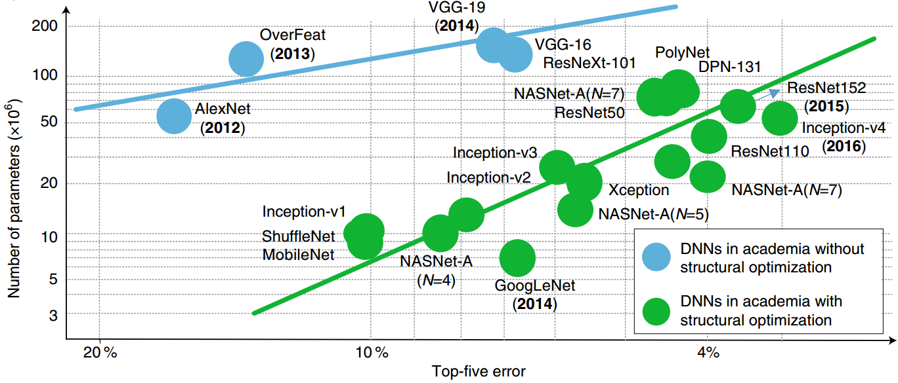
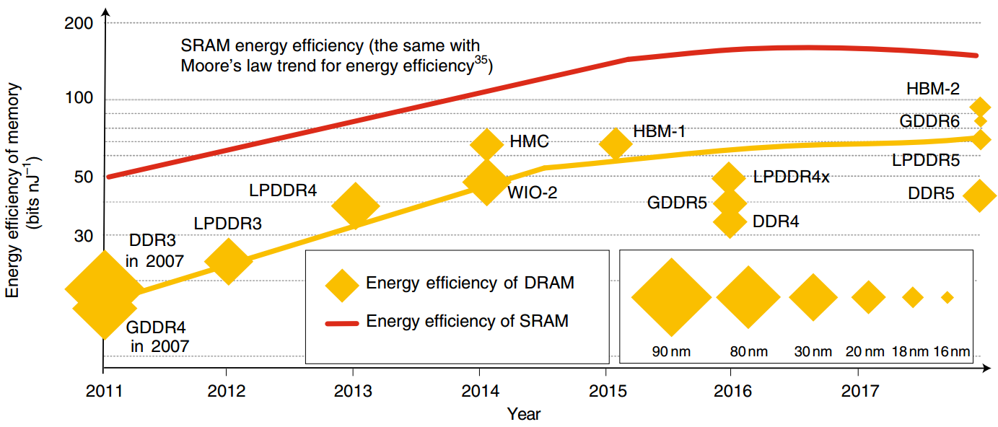
Background
Computation & Storage Demand > Supply
Number of DNN operations increases exponentially
Performance density almost stops increasing
Number of DNN parameters increases exponentially
Energy efficiency of memory stops increasing
[1] Xu, Xiaowei, et al. "Scaling for edge inference of deep neural networks." Nature Electronics 1.4 (2018): 216.
[2] Sutter, H. The free lunch is over: A fundamental turn toward concurrency in software. Dr Dobb’s J. 30, 202–210.
Notes:
However, with the development of neural networks. Describe Figure. With the increasing demand on accuracy, the computation requirement increase exponentially. On the other hand, with the end of moors’ law, the computation density in hardware almost stop. As a result, the computation demand is surplus to the hardware supply. A similar situation occurs in the storage.

Slide 6
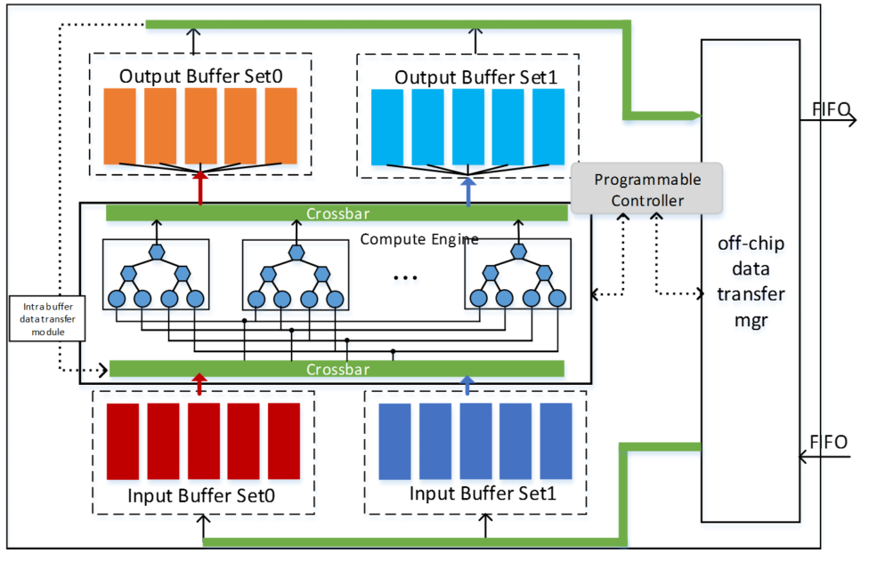
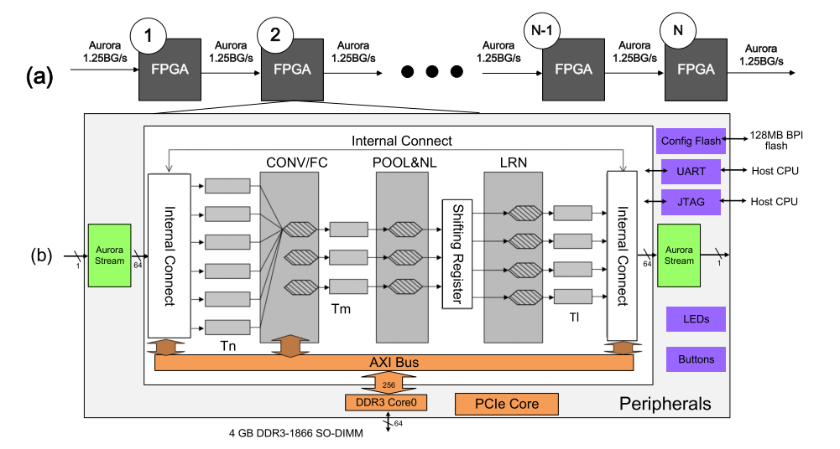
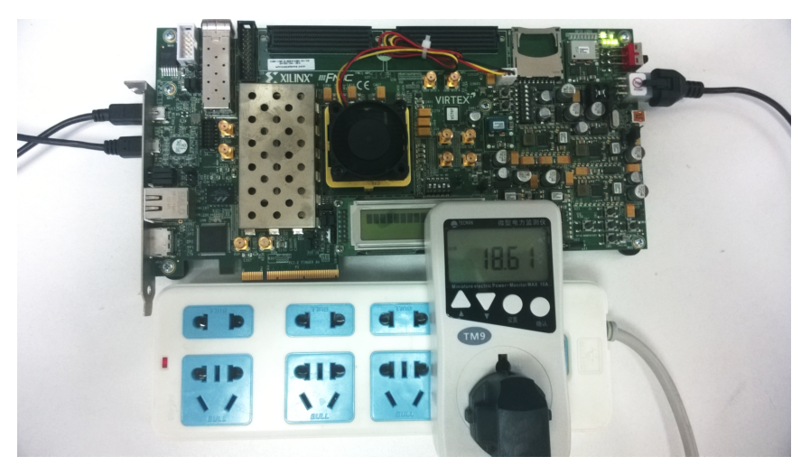
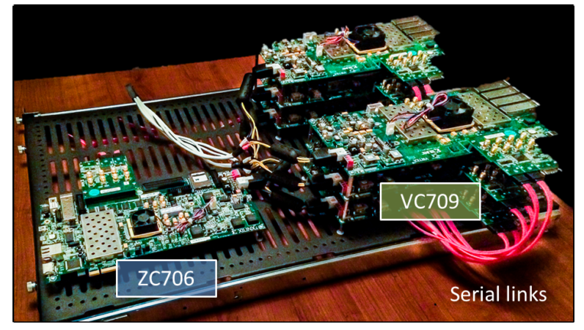
Background
Response to Limited Resource: Pipelining Multi-FPGA
Pipelined FPGAs
Single-FPGA
Pipeline→ High Throughput
Latency is not improved
Limited Resource → Limited Performance
[Ref] C. Zhang et al. Optimizing fpga-based accelerator design for deep convolutional neural networks. In Proc. of FPGA, pages 161–170. ACM, 2015.
[Ref] C. Zhang et al. Energy-efficient cnn implementation on a deeply pipelined fpga cluster. In Proc. of ISLPED, pages 326–331, 2016.
Notes:
Multi-FPGA is a good solution to response to the limited resource.
In the early design stage, the single FPGA is applied to accelerate the DNN applications.
To increase hardware resource, it is naturally to employing multiple FPGAs to increase performance.
As shown in this slides, authors apply pipelining FPGAs to boost performance.

Slide 7
Background
Pipelining Multi-FPGA: Design Flow
Accelerator Design Parameter
Notes:
We exam the design flow and made three observations.
We outline the design flow in this slides, where a convolutional neural network is given. And it will based on the pipelining idea to be partitioned into different pipeline stages, and map each stage to one FPGA.
To achieve the design, it is based on a performance model, which will determine the design parameters for the accelerator in each FPGA.
Then, the input DNN is divided to form the pipelining FPGAs.
In the following, let’s first see the accelerator design

Slide 8
Background
Accelerator Design Parameters
L
1
L
2
L
3
L
4
1
Layer Model
N
M
K
R
B
…
K
C
…
IFM
L₂=
(
B, M, N, R, C, K
)
OFM
FPGA-based Acceleration
Batch Size (B)
# of IFM
Feature Maps (N)
Column of IFM (C)
# of OFM
Features Maps (M)
Row of IFM (R)
Kernel Size (K)
Loop Tiling
Tm
Tn
Tr
Tc
IFM
Weights
OFM
Layer Parameters:
L=(B, M, N, R, C, K)
Tiling Parameters:
(Tm, Tn, Tr, Tc)
On-chip Memory cannot hold all data
Notes:
As shown in this slides, a convolution layer can be modeled using different parameters according to the activations and weigths.
For the accelerator design, activations and weights are initially stored in off-chip memory.
To execute the accelerator, data will be first moved to on-chip memory in FPGA. Then, computations are conducted in the FPGA to produce the output. Finally, the output will store to the off-chip memory.
However, during this process, due to the limited on-chip memory, we cannot move all data to FPGA once. As a result, loop tiling is proposed to only move partial data to the FPGA. And we can tile the activations and weights along different directions.
These tiling parameters are called design parameters.

Slide 9
Motivation
Design Parameters Will Significantly Affect the Performance
192
128
…
128
…
Observation:
13
…
weights
13
Different design parameters lead to different performance
13
13
Fig. Convolution of Layer 5 in AlexNet
Optimizations on design parameters
Notes:
After we implement a convolution layer to one FPGA with different design parameters, we can obtain such a design space graph, where each point indicates a design. We have the observation here that different design parameters will lead different performance. Hence, it is important to optimize design parameters.

Slide 10
Background
Pipelining Multi-FPGA Design Flow
Performance Model
Accelerator Design Parameter
Notes:
As shown in this slides, the determination of design parameters depend on the performance model. We next show the effects of performance model on optimizing designs.

Slide 11
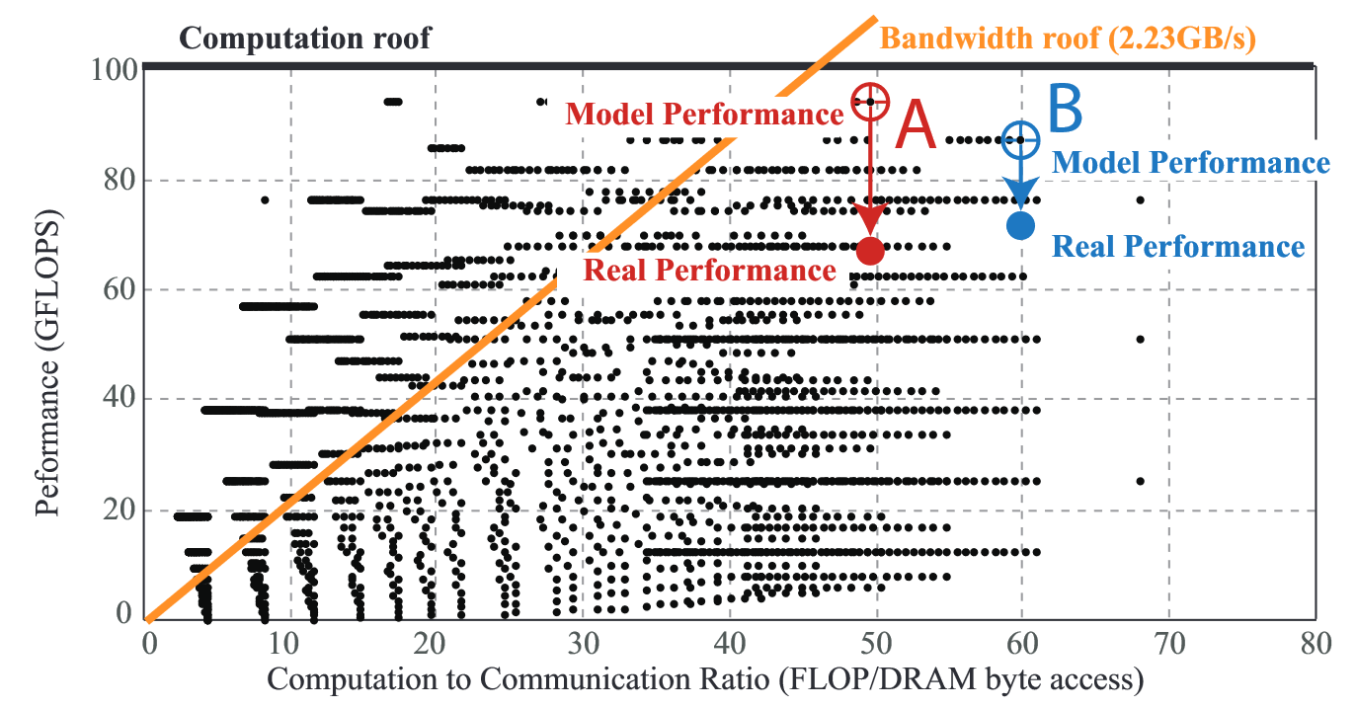
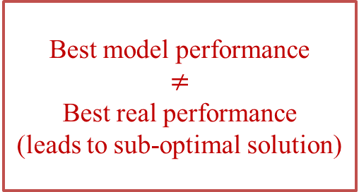
Motivation
Inaccurate Performance Model Leads to Sub-Optimal Design
Observation:
192
128
…
128
…
Without fine-grained memory access model and inter-FPGA communication model
13
…
weights
13
13
13
Fig. Convolution of Layer 5 in AlexNet
Inaccurate performance model for multi-FPGA
Best model performance
$$≠$$
Best real performance
(leads to sub-optimal solution)
Fig. Real Performance of Layer 5 in Alexnet on ZCU 102
Notes:
As shown in this slides, after we implementing two specific designs, A and B onto the Xilinx board. We observe that the existing performance model without fin-grained communication model is inaccurate. In addition, we observe that the best model performance will not be the best real performance. This indicates that the inaccurate model will lead to the sup-optimal solution.

Slide 12
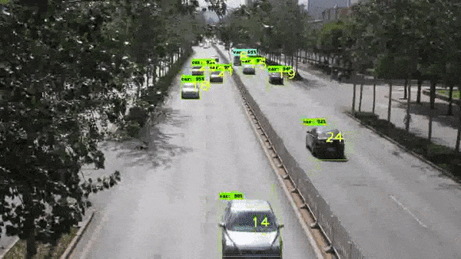
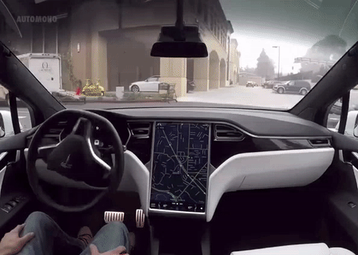
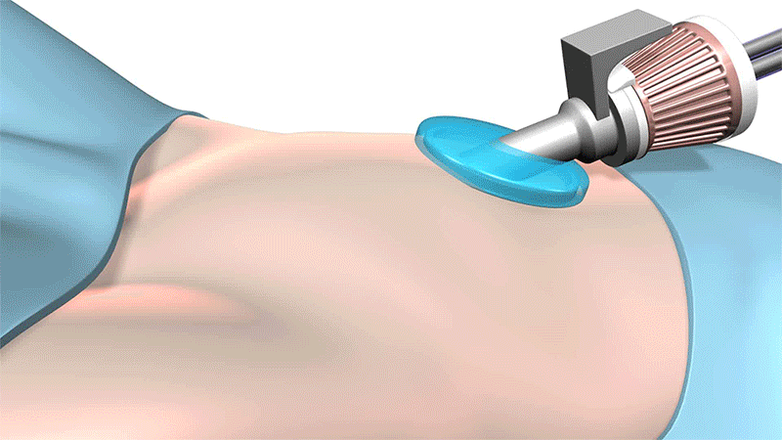
Motivation
Pipelining Multi-FPGA Design Flow
Traffic Surveillance
Performance Model
Accelerator Design Parameter
Pipelining Design
Will Increase Latency
Self-Driving Vehicle
[ref.1] Google’s Waymo
[ref.2] da Vinci Surgical Robot at St. Francis Health Center - Robotic Gizmos
Robots in Surgery
Notes:
Finally, let’s review the pipelining design. Such a design can improve throughput benefiting from multiple FPGAs, but it cannot improve and even degrade the latency. On the other hand, the current applications mainly have the real-time requirement. In consequence, we need innovations in multi-FPGA design.

Slide 13
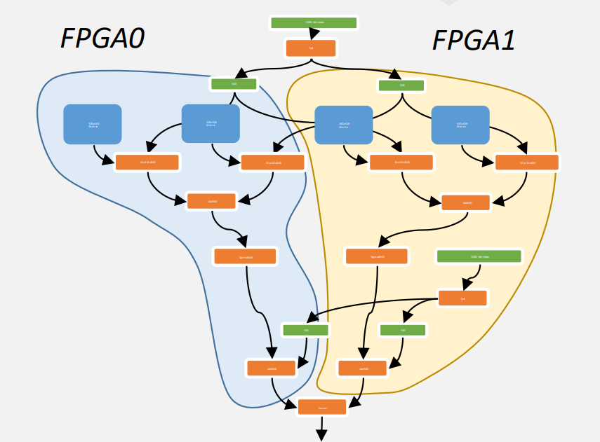
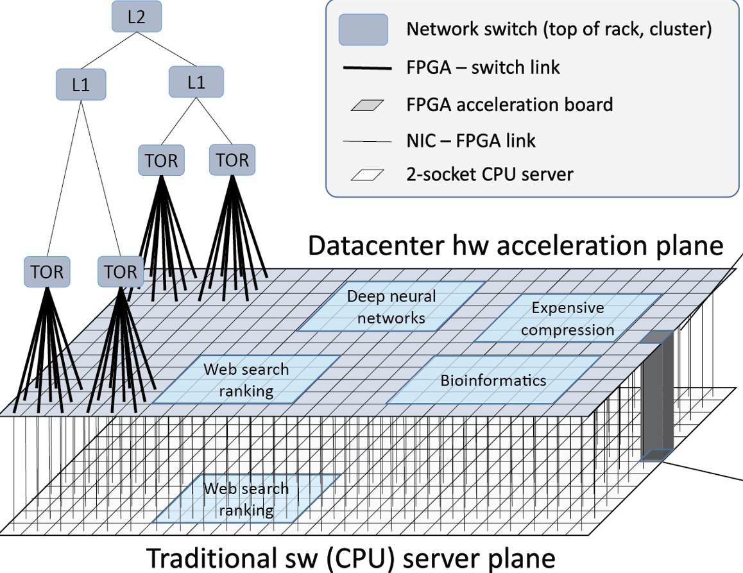
Background
Response to Real-Time Requirement: Parallel Multi-FPGA!
Microsoft Brainwave
Weight Locking based Multi-FPGA
Lock weights to multiple FPGAs → Specific for RNN
Not applicable for sharing weights (e.g. CNN)
[Ref] Eric Chung, et al. Serving DNNs in Real Time at Datacenter Scale with Project Brainwave, In IEEE Micro, 2018
Notes:
Microsoft Brainwave project made the first trial to achieve real-time performance. They lock weights on FPGAs to avoid off-chip memory access. However, such approach is suitable for RNNs but not for CNN with complicated data dependency.

Slide 14
Outline
Introduction
Super-LIP Framework
Overview
XFER Design
Optimizing Design Parameters with a more Accurate Model
Experimental Results
Ultimate Goal
Notes:
In this work, we present Super-LIP framework to address all the above problems.

Slide 15
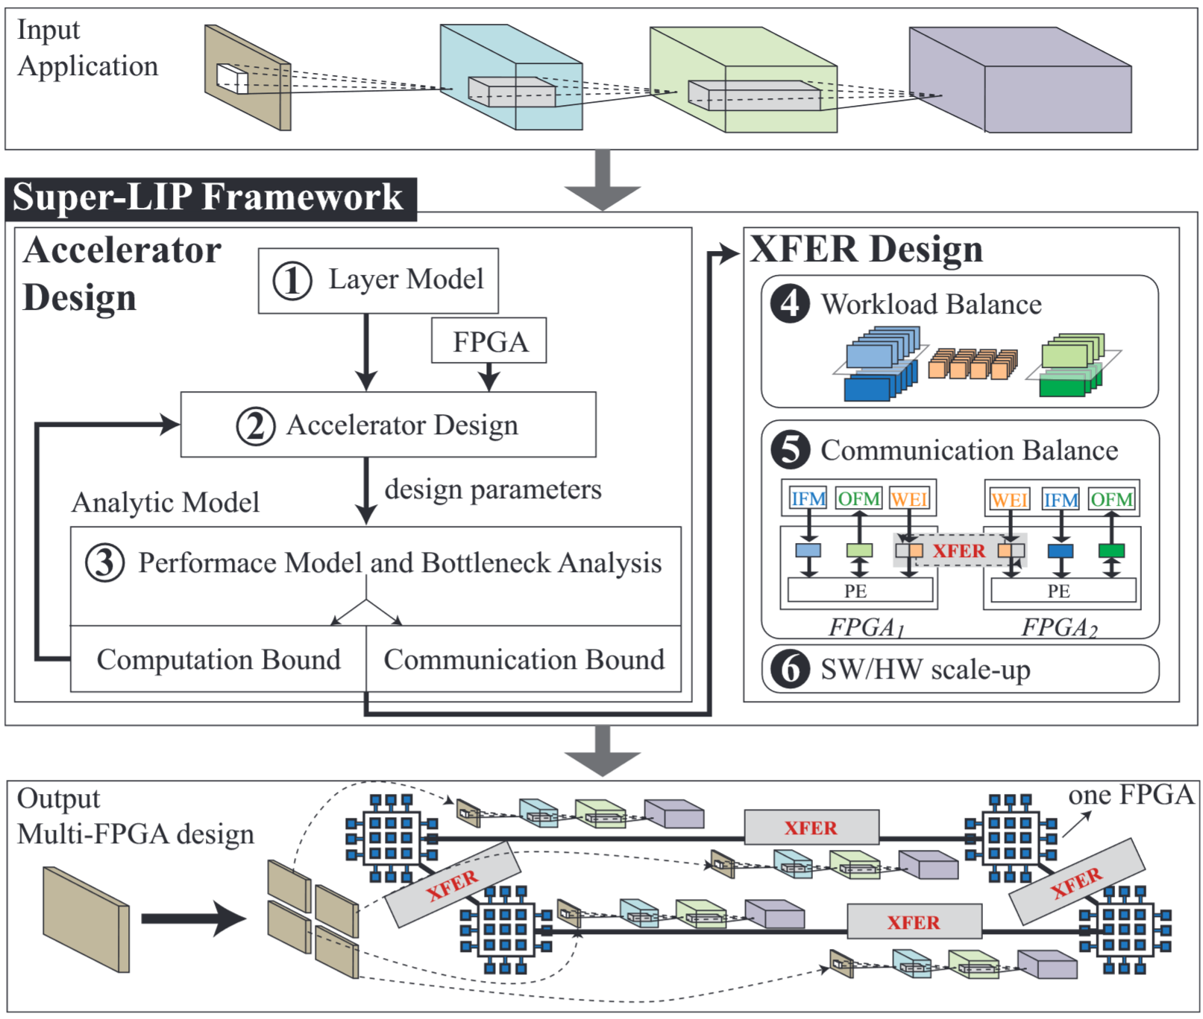
Overview
Super-LIP Framework
Optimizing Design Parameters with a more Accurate Model
Accelerator Design
XFER Design
XFER Design
Targeting on Minimizing Latency
Notes:
First, we propose a novel XFER design that targets on minimizing latency.
Second, we proposed a optimization model which can accurately predict the latency of a given design. In addition, the model can support the proposed XFER design with multiple FPGAs.

Slide 16
XFER Design
Super-LIP Framework
Optimizing Design Parameters with a more Accurate Model
Accelerator Design
XFER Design
XFER Design
Targeting on Minimizing Latency

Slide 17
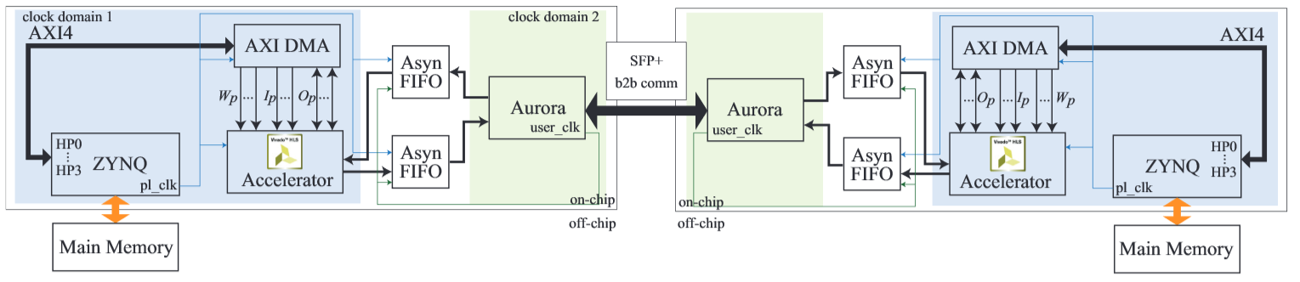
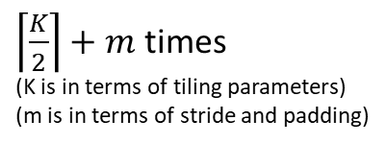
XFER Design
Double Computation Resource Cannot Double Performance
loop tiling +
partition IFM
Application
Optimization
FPGA 1
FPGA 2
FPGA Design
K times
(in terms of tiling parameters)
$\left\lceil \frac{K}{2}\right\rceil +m$ times
(K is in terms of tiling parameters)
(m is in terms of stride and padding)
NN | Operation | Single | w/o XFER | Note
AlexNet Layer 5 | Comm_IFM | 2,612
 | Comm_Weights | 5,658
 | Comm_OFM | 368
 | Computation | 3,326
w/o XFER
1,412
2,953
234
1,782
Note
1.91X Speedup
Notes:
Page 17:
To alleviate the performance bottleneck, the straightforward way is to add resource. (click)
We consider to employ an additional FPGA to accelerate the process. (click)
To utilize two FPGAs, we partition the convolutional layer as shown in the slides, and deploy each partition to one FPGA. (click)
In this way, the number of iterations reduced from K to this number. Note that, due to border, we cannot perfectly achieve double performance with double resource. (click)
As shown in the table, we achieve 1.9 times speedup. (click)
Here, we have two observations. First, weights are still dominated by loading weights, And second, unlike IFM, OFM, and computation, all weights are duplicated in two FPGAs.

Slide 18
XFER Design
XFER: Achieve Super-Linear Speedup by Transferring Accesses from Off-Chip Memory to Inter-FPGA Connections
loop tiling +
partition IFM +
partition weights
Application
Optimization
FPGA 1
FPGA 2
FPGA Design
XFER
NN | Operation | Single | w/o XFER | w/ XFER | Note
AlexNet Layer 5 | Comm_IFM | 2,612 | 1,412
 | Comm_Weights | 5,658 | 2,953
 | Comm_OFM | 368 | 234
 | Computation | 3,326 | 1,782
w/ XFER
1,412
1,695
234
1,782
Note
Bottleneck Moves to Comp. 3.18X Speedup
Notes:
Page 18:
To further accelerate the system. We partition the weights into two groups, and two FPGAs will share the weights through inter-FPGA links.
As a results, we can significantly reduce the latency of loading weights. And achieve the super-linear performance.
In this example, we can achieve more than 3 times speedup using only 2 FPGAs.

Slide 19
XFER Design
Application Optimization —— Partitioning
Weight Sharing: (P_{b}, P_{r}, P_{c})
IFM Sharing: (P_{m})

Slide 20
XFER Design
Super-LIP Framework
Optimizing Design Parameters with a more Accurate Model
Accelerator Design
XFER Design
XFER Design
Targeting on Minimizing Latency

Slide 21
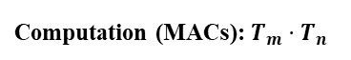
Accelerator Design —— Accurate Model
Accelerator Design —— On-Chip Design
Accelerator Model
Communication Parameters (bit/cycle):
Ip: bandwidth for loading IFM
Wp: bandwidth for loading weights
Op: bandwidth for storing OFM
Computation (MACs): $T_{m}⋅T_{n}$
OFM Stationary Data Flow

Slide 22
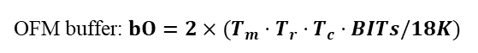
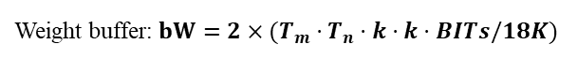
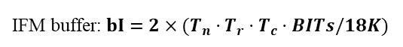
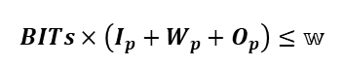
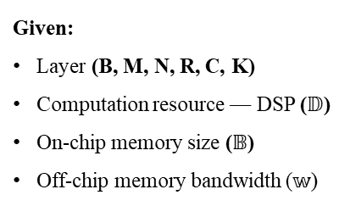
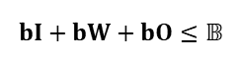
Accelerator Design —— Accurate Model
Accelerator Design —— Optimization under Resource Constraints
Problem Definition
Determine:
Tiling: (Tm, Tn, Tr, Tc)
Bandwidth allocation: (Ip, Wp, Op)
Partition: (Pb, Pr, Pc, Pm)
Given:
Layer (B, M, N, R, C, K)
Computation resource — DSP ($𝔻$)
On-chip memory size ($𝔹$)
Off-chip memory bandwidth ($𝕨$)
Objective:
Minimizing latency under resource constraints
Computation Resource Constraint
Computation(32-bit): $T_{m}⋅T_{n}≤𝔻$; or (16-bit) $5⋅T_{m}⋅T_{n}≤𝔻$;
Memory Resource Constraints
IFM buffer: $bI=2×(T_{n}⋅T_{r}⋅T_{c}⋅BITs/18K)$
bitwidth(32b or 16b)
Weight buffer: $bW=2×(T_{m}⋅T_{n}⋅k⋅k⋅BITs/18K)$
Communication Parameters (bit/cycle):
Ip: bandwidth for loading IFM
Wp: bandwidth for loading weights
Op: bandwidth for storing OFM
OFM buffer: $bO=2×(T_{m}⋅T_{r}⋅T_{c}⋅BITs/18K)$
BRAM blokc size
$$bI+bW+bO≤𝔹$$
Communication Resource Constraint
Computation (MACs): $T_{m}⋅T_{n}$
$$BITs×\left(I_{p}+W_{p}+O_{p}\right)≤𝕨$$
OFM Stationary Data Flow

Slide 23
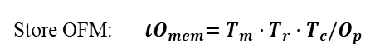
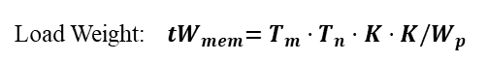
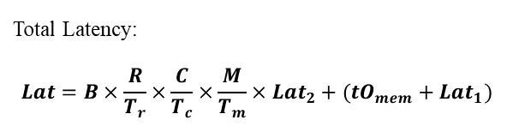
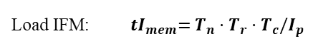
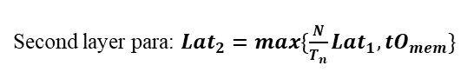
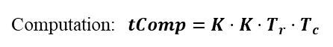
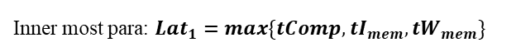
Accelerator Design —— Accurate Model
Accelerator Design —— Optimization under Resource Constraints
Problem Definition
Determine:
Tiling: (Tm, Tn, Tr, Tc)
Bandwidth allocation: (Ip, Wp, Op)
Partition: (Pb, Pr, Pc, Pm)
Given:
Layer (B, M, N, R, C, K)
Computation resource — DSP ($𝔻$)
On-chip memory size ($𝔹$)
Off-chip memory bandwidth ($𝕨$)
Objective:
Minimizing latency under resource constraints
Memory Access and Computation Latency
Load IFM: ${ tI}_{mem}=T_{n}⋅T_{r}⋅T_{c}/I_{p}$
Load Weight:${ tW}_{mem}=T_{m}⋅T_{n}⋅K⋅K/W_{p}$
Store OFM:${ tO}_{mem}=T_{m}⋅T_{r}⋅T_{c}/O_{p}$
Computation:$tComp=K⋅K⋅T_{r}⋅T_{c}$
Latency under Parallelism: OFM stationary
Communication Parameters (bit/cycle):
Ip: bandwidth for loading IFM
Wp: bandwidth for loading weights
Op: bandwidth for storing OFM
Inner most para: $Lat_{1}=max\{tComp,{tI}_{mem},{tW}_{mem}\}$
Lat1
Second layer para: $Lat_{2}=max\{\frac{N}{T_{n}}Lat_{1},{tO}_{mem}\}$
Lat2
Total Latency:
$$Lat=B×\frac{R}{T_{r}}×\frac{C}{T_{c}}×\frac{M}{T_{m}}×Lat_{2}+({tO}_{mem}+Lat_{1})$$
# of loops
Pipeline loading time
Computation (MACs): $T_{m}⋅T_{n}$
Lat
OFM Stationary Data Flow

Slide 24
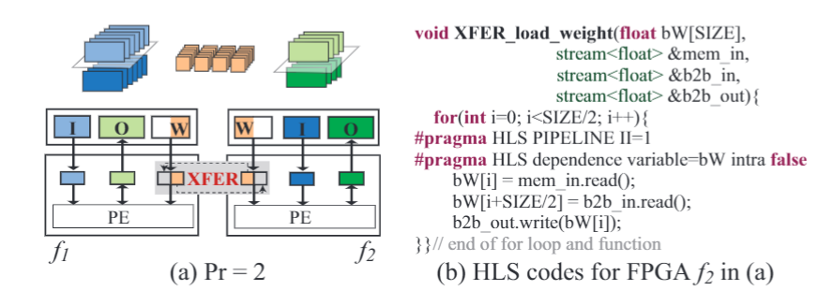
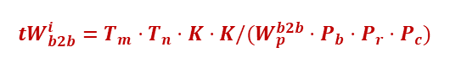
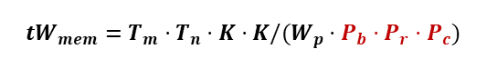
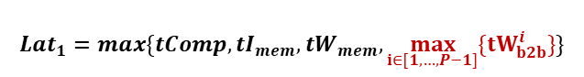
XFER Design
XFER Design —— Weight Sharing
Model Modifications:
Load Weight:
$${tW}_{mem}=T_{m}⋅T_{n}⋅K⋅K/(W_{p}⋅P_{b}⋅P_{r}⋅P_{c})$$
Inter-FPGA latency:
$${tW}_{b2b}^{i}=T_{m}⋅T_{n}⋅K⋅K/(W_{p}^{b2b}⋅P_{b}⋅P_{r}⋅P_{c})$$
Inner most para:
$$Lat_{1}=max\{tComp,{tI}_{mem},{tW}_{mem},\max_{i∈[1,…,P−1]}{\{tW_{b2b}^{i}\}}\}$$

Slide 25
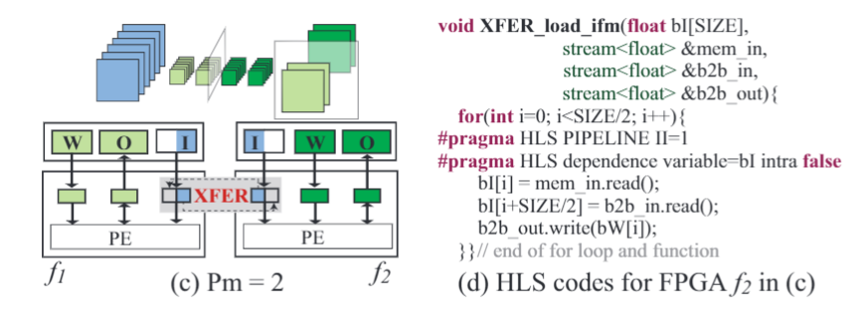
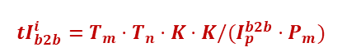
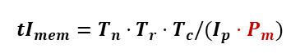
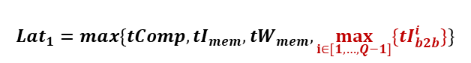
XFER Design
XFER Design —— IFM Sharing
Model Modifications:
Load IFM:
$${tI}_{mem}=T_{n}⋅T_{r}⋅T_{c}/(I_{p}⋅P_{m})$$
$${tI}_{b2b}^{i}=T_{m}⋅T_{n}⋅K⋅K/(I_{p}^{b2b}⋅P_{m})$$
Inter-FPGA latency:
Inner most para:
$$Lat_{1}=max\{tComp,{tI}_{mem},{tW}_{mem},\max_{i∈[1,…,Q−1]}{\{{tI}_{b2b}^{i}\}}\}$$

Slide 26
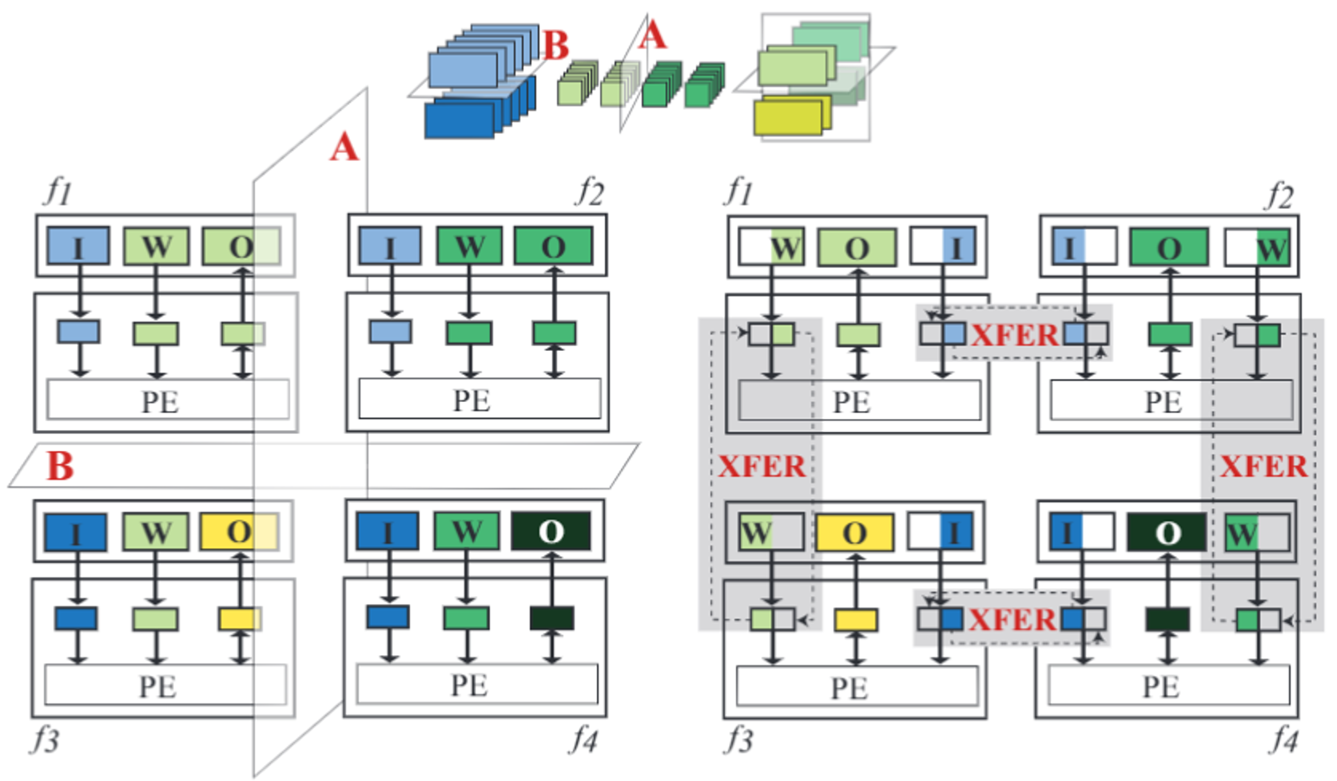
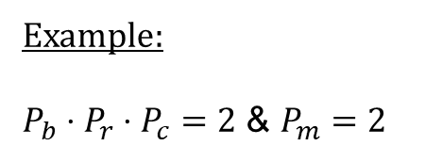
XFER Design
XFER Design —— Scale-Up
Example:
$P_{b}⋅P_{r}⋅P_{c}=2$ & $P_{m}=2$
Topology: 2D-torus
Data Movement: Pipelining

Slide 27
XFER Design
Recap —— Super-LIP Framework
Optimizing Design Parameters with a more Accurate Model
Accelerator Design
XFER Design
XFER Design
Targeting on Minimizing Latency

Slide 28
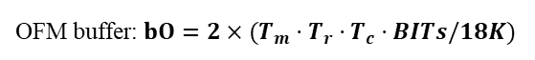
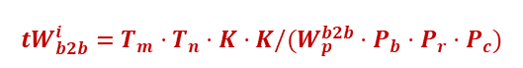
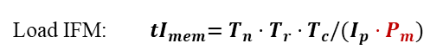
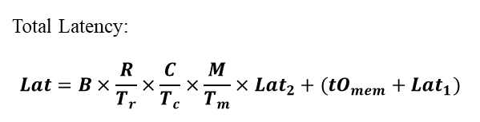
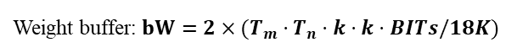









Accelerator Design —— Accurate Model
Model Overview
1. Resource Constraints
2. Memory Access and Computation Latency
Computation(32-bit): $T_{m}⋅T_{n}≤𝔻$; or (16-bit) $5⋅T_{m}⋅T_{n}≤𝔻$;
Load IFM:${ tI}_{mem}=T_{n}⋅T_{r}⋅T_{c}/(I_{p}⋅P_{m})$
IFM buffer: $bI=2×(T_{n}⋅T_{r}⋅T_{c}⋅BITs/18K)$
Load Weight:
Weight buffer: $bW=2×(T_{m}⋅T_{n}⋅k⋅k⋅BITs/18K)$
$${tW}_{mem}=T_{m}⋅T_{n}⋅K⋅K/(W_{p}⋅P_{b}⋅P_{r}⋅P_{c})$$
OFM buffer: $bO=2×(T_{m}⋅T_{r}⋅T_{c}⋅BITs/18K)$
$$bI+bW+bO≤𝔹$$
Store OFM:${ tO}_{mem}=T_{m}⋅T_{r}⋅T_{c}/O_{p}$
$$BITs×\left(I_{p}+W_{p}+O_{p}\right)≤𝕨$$
Computation:$tComp=K⋅K⋅T_{r}⋅T_{c}$
3. Parallelism (Pipelining and Double Buffer)
4. Communication among Multiple FPGAs (XFER)
Inner most para:
Lat1
$$Lat_{1}=max\{tComp,{tI}_{mem},{tW}_{mem},\max_{i∈\left[1,…,P−1\right]}\left\{tW_{b2b}^{i}\right\}$$
$,\max_{i∈[1,…,Q−1]}{\{{tI}_{b2b}^{i}\}}\}$
Transfer IFM:
$${tI}_{b2b}^{i}=T_{m}⋅T_{n}⋅K⋅K/(I_{p}^{b2b}⋅P_{m})$$
Lat2
Second layer para: $Lat_{2}=max\{\frac{N}{T_{n}}Lat_{1},{tO}_{mem}\}$
Transfer Weights:
$${tW}_{b2b}^{i}=T_{m}⋅T_{n}⋅K⋅K/(W_{p}^{b2b}⋅P_{b}⋅P_{r}⋅P_{c})$$
Lat
Total Latency:
$$Lat=B×\frac{R}{T_{r}}×\frac{C}{T_{c}}×\frac{M}{T_{m}}×Lat_{2}+({tO}_{mem}+Lat_{1})$$
Objective: $min=Lat$

Slide 29
Outline
Introduction
Super-LIP Framework
Experimental Results
Ultimate Goal

Slide 30


Comparison with Existing Designs and GPU Platforms
Testbed:
CNN: AlexNet
FPGA: Xilinx ZUC102 FPGAs connected by SFP+ Links
Comparison results of XFER with comparisons to GPUs and the existing FPGA designs
XFER
Lowest
Latency
among all
competitors
Notes:
Page 22:
Finally, we conduct experiments on Xilinx ZCU102 boards.
Compared with GPU and the existing FPGA implementations, we can see that XFER can achieve the lowest latency.

Slide 31

Comparison with Single-FPGA Design on ZCU102 Boards
Comparison results of XFER with SOTA single FPGA design
Achieve Super-Linear Speedup for both 32-bits and 16-bits implementations
Notes:
Page 23:
Compare with the single-FPGA design, we can see that we can achieve more than 2 times speedup with 2 FPGAs.

Slide 32
Model Accuracy Evaluation
Ours: average deviation is only 2.53%
Existing model: deviation is up to 45.47%
We can accurately estimate performance of multiple FPGAs
Performance Bottleneck Detection and Alleviation using the proposed model

Slide 33
Design Space Exploration on AlexNet, SqueezeNet, VGG, YOLO
With the increasing of the size of FPGA cluster, we can consistently achieve lower latency

Slide 34
Outline
Introduction
Super-LIP Framework
Experimental Results
Ultimate Goal

Slide 35

Co-Design Neural Networks and Scalable FPGA Implementations
ICCAD’19
DAC’19 Best Paper Nomination
This work, CODES+ISSS’19
ASP-DAC’20 Best Paper Nomination

Slide 36


Open Source
https://github.com/PITT-JZ-COOP/XFER_FPGA
Thank You!
Performance Model
XFER Design
HLS
SDK
Vivado_project

Slide 38
Thank You!
Weiwen Jiang
Postdoctoral Researcher
University of Notre Dame
wjiang2@nd.edu
https://wjiang.nd.edu

Slide 39



Achieving Super-Linear Speedup across Multi-FPGA for Real-Time DNN Inference
CODES+ISSS 2019: International Conference on Hardware/Software Codesign and System Synthesis
Achieving Super-Linear Speedup across Multi-FPGA for Real-Time DNN Inference
Weiwen Jiang, Edwin H.-M. Sha, Xinyi Zhang, Lei Yang, Qingfeng Zhuge, Yiyu Shi, Jingtong Hu
University of Pittsburgh
East China Normal University
University of Notre Dame
Latency
$$\frac{2 CUPs}{Bandwidth}$$
$$\frac{CUP/2}{Bandwidth}$$
$$\frac{1 CUP}{Bandwidth}$$
Weiwen Jiang
Postdoctoral Researcher
University of Notre Dame
wjiang2@nd.edu
https://wjiang.nd.edu
4X with 2 flasks
Super-Linear Speedup
2X with 2 flasks
Linear Speedup
flask

Slide 40
XFER Design
Performance on Single FPGA Bounded by Limited Resource
Application
Optimization
loop tiling
FPGA 1
FPGA 2
FPGA Design
K times
(in terms of tiling parameters)
NN | Operation | Cycles | Note
AlexNet Layer 5
NN | Operation | Cycles | Note
AlexNet Layer 5 | Comm_IFM | 2,612 | Performance Dominated by Comm_Weights Latency is 5,658
 | Comm_Weights | 5,658
 | Comm_OFM | 368
 | Computation | 3,326
Notes:
Page 16:
Next, I’ll show an example to see how can XFER achieve super-linear performance with two FPGAs.
The right part show the typical process of a convolutional layer with tiling. That means, each time, only the data with color will be load on FPGA to be processed. (click)
These data are originally in off-chip memory. We use the black square to represent input feature map, and the red square to represent weights.
These data will be loaded into on-chip buffer (click), and then accelerator use these data to generate the partial results of output feature map. (click)
These operations will be conducted in a fine-grained pipeline fashion, and therefore, the maximum cycles of these operations will dominate the whole system. (click)
We show an example of AlexNet, where loading weights dominate the latency of the whole system.

Slide 41
Illustration Example
Magic can be Played in Computing Systems
, But Has Challenges
Application Level
How to PARTITION data/task
(data and tasks are coupled)
Co-Design Level
How to build SW/HW MODEL to accurately predict latency
Hardware Level
How to SCALE-UP the size of FPGA cluster

Slide 42
Motivation and Challenges
Off-Chip Memory Accesses become Performance Bottleneck
Observation 2:
192
128
…
128
…
…
Communication to access off-chip memory is performance bottleneck
13
weights
13
13
13
Fig. Convolution of Layer 5 in AlexNet
Mitigate the communication load between on-chip and off-chip memory
Fig. Design Space Exploration of Layer 5 in Alexnet on ZCU 102

Slide 43

Motivation and Challenges
High-Speed Inter-FPGA Communication Makes Opportunities
FPGA 1
FPGA 2
Feature and Results
Different clock domains for computation (low) and communication (high)
Communication not go through Off-Chip Memory, but directly switch between on-chip buffers

Slide 44







Accelerator Design —— Accurate Model
Accelerator Design —— Model Overview
1. Resource Constraints
2. Memory Access and Computation Latency
Computation(32-bit): $T_{m}⋅T_{n}≤𝔻$; or (16-bit) $5⋅T_{m}⋅T_{n}≤𝔻$;
Load IFM: ${ tI}_{mem}=T_{n}⋅T_{r}⋅T_{c}/I_{p}$
IFM buffer: $bI=2×(T_{n}⋅T_{r}⋅T_{c}⋅BITs/18K)$
Load Weight:${ tW}_{mem}=T_{m}⋅T_{n}⋅K⋅K/W_{p}$
Weight buffer: $bW=2×(T_{m}⋅T_{n}⋅k⋅k⋅BITs/18K)$
Store OFM:${ tO}_{mem}=T_{m}⋅T_{r}⋅T_{c}/O_{p}$
OFM buffer: $bO=2×(T_{m}⋅T_{r}⋅T_{c}⋅BITs/18K)$
$$bI+bW+bO≤𝔹$$
Computation:$tComp=K⋅K⋅T_{r}⋅T_{c}$
$$BITs×\left(I_{p}+W_{p}+O_{p}\right)≤𝕨$$
3. Parallelism (Pipelining and Double Buffer)
4. Communication among Multiple FPGAs (XFER)
Lat1
Inner most para: $Lat_{1}=max\{tComp,{tI}_{mem},{tW}_{mem}\}$
Second layer para: $Lat_{2}=max\{\frac{N}{T_{n}}Lat_{1},{tO}_{mem}\}$
Objective: $min=Lat$
Lat2
Total Latency:
$$Lat=B×\frac{R}{T_{r}}×\frac{C}{T_{c}}×\frac{M}{T_{m}}×Lat_{2}+({tO}_{mem}+Lat_{1})$$
Lat

Slide 45


Accelerator Design —— Accurate Model
Accelerator Design —— Bottleneck Detection
$$Lat_{1}=max\left\{tComp,{tI}_{mem},{tW}_{mem}\right\}; Lat_{2}=max\{\frac{N}{T_{n}}Lat_{1},{tO}_{mem}\}$$
Lemma: Given a CNN layer and its design parameters, we can detect the performance bottlenecks according to Lat1 and Lat2:
If Lat2 is dominated by ${tO}_{mem}$, bottleneck is on storing OFM, otherwise
If Lat1 is dominated by ${tI}_{mem}$, bottleneck is on loading IFM
If Lat1 is dominated by ${tW}_{mem}$, bottleneck is on loading weights
If Lat1 is dominated by $tComp$, bottleneck is on limited computation resource

Slide 46


XFER Design
XFER Design —— Scale-Up
Example 1:
$P_{b}⋅P_{r}⋅P_{c}=2$ & $P_{m}=2$
Example 2:
$P_{b}⋅P_{r}⋅P_{c}=4$ & $P_{m}=3$
Topology: 2D-torus
Data Movement: Pipelining

